Slide 1

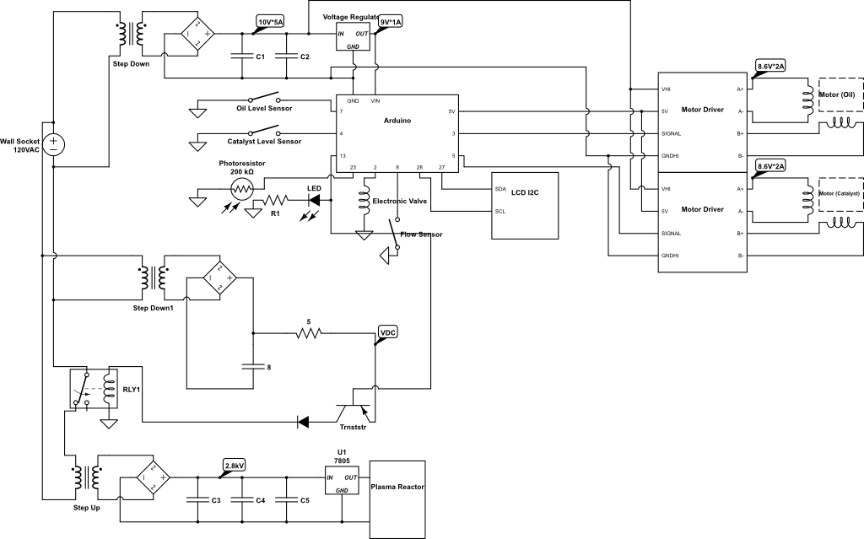

Slide 2
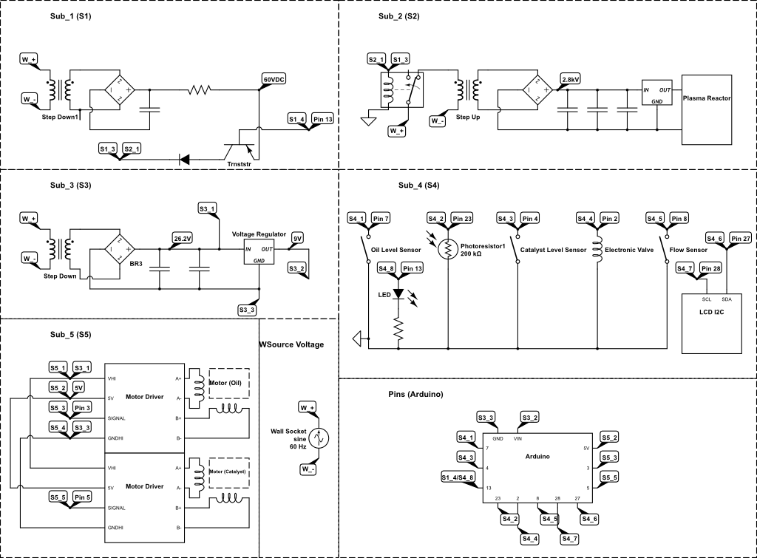

Slide 3
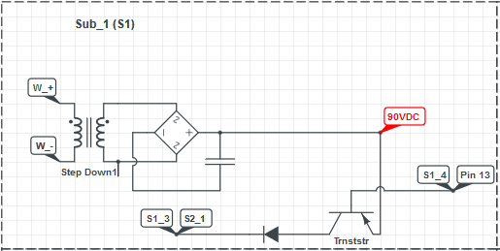
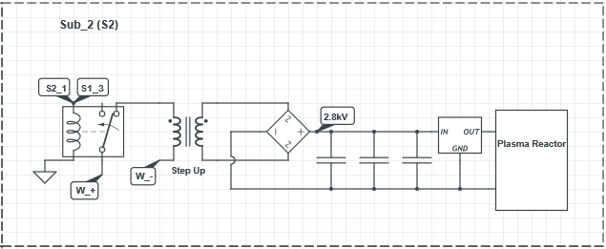
120VAC goes in to transformer and steps down to 90 V.
Converted to DC with rectifier bride.
Filtered with Capacitor.
No voltage flows unless transistor is activated by Arduino.
Voltage flows out of emitter and activated relay in Sub_2
After the relay is activated, voltage flow through the transformer and steps 120VAC to roughly 3kV.
Voltage is converted to DC using rectifier.
Multiple Capacitors are used to filter the higher frequencies.
A voltage regulator is used to account for pulsing voltage.
The plasma reactor is activated.

Slide 4
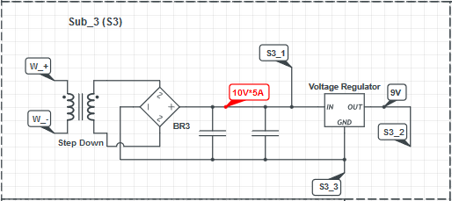
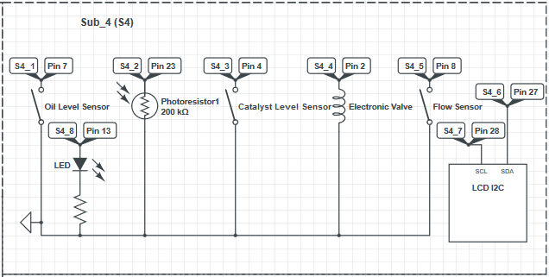
120VAC flows through the transformer and converts it to 10VAC.
A rectifier bridge converts it to DC.
2 capacitors at different capacitance filters out some of the higher frequencies.
This 10V goes to the motor drivers.
A voltage regulator is used to give power to the Arduino.
The oil sensor is switched on when the oil is too low.
The catalyst sensor is switched on when the catalyst solution is too low.
The LED is powered when the relay is switched on in Sub_2.
The Photo Resistor sends a signal to the Arduino when the plasma reactor is activated.
The electronic valve is toggled when the photo resistor reads a signal.
The flow sensor is activated when the oil/catalyst solution is flowing through it.

Slide 5
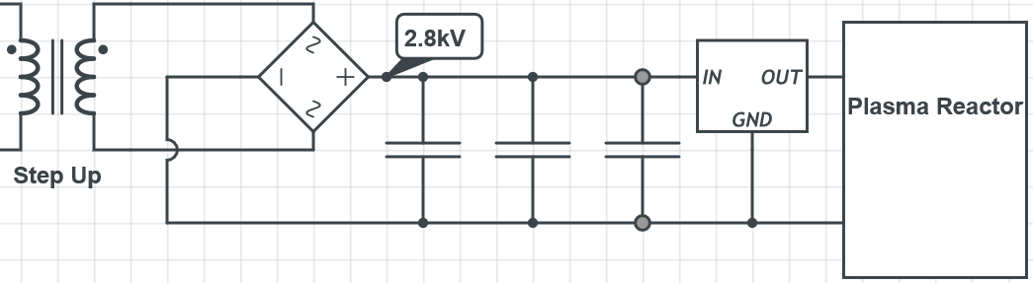
2.8kV is our current design but aiming for 3kV.
120VAC flows in to a transformer with a step ratio of 25.
This is filtered with multiple caps as to send a cleaner signal to the voltage regulator.
The plasma reactor is going to be given 3kV at 100mA. Because of this, there will be pulsing voltage issues. This requires a regulator to give a stable signal to plasma reactor.

Slide 6
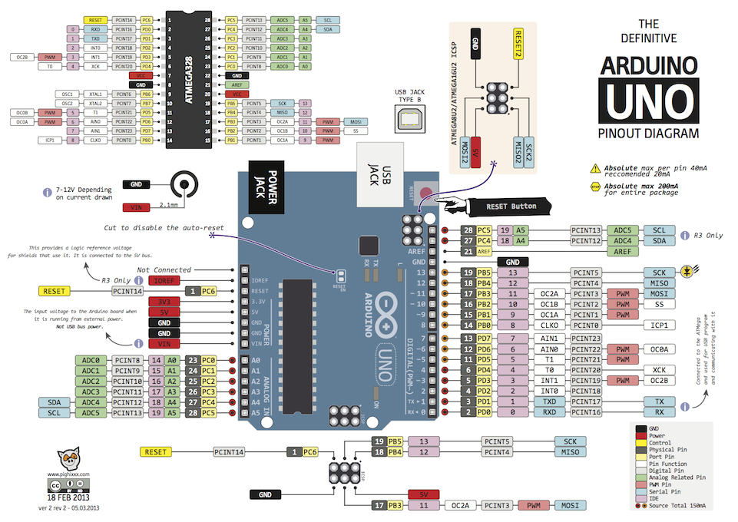

Slide 7
Typical Simulation:
If (Power = on) = start pumps.
If (flow sensor reads liquid) relay = on
If (Plasma Reactor = on) toggle valve
While (Oil Level Sensor = not low && catalyst level sensor = not low) keep motors on. If (shutdown signal = on) toggle switch, power off machine.

Slide 8
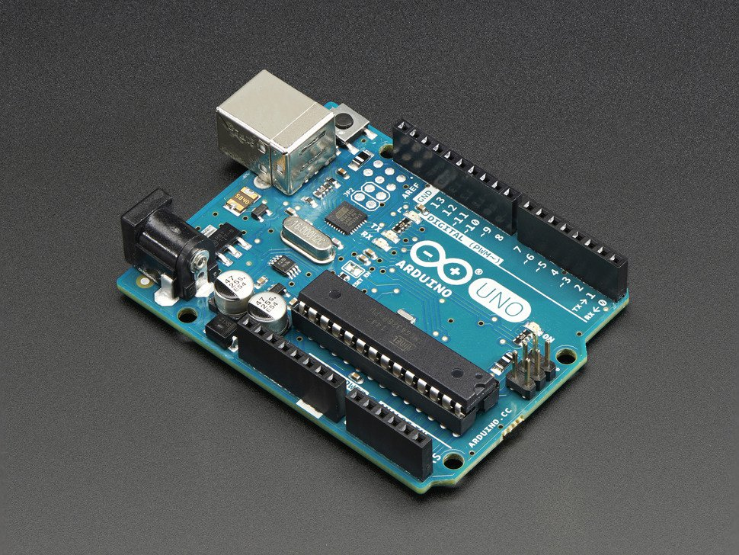
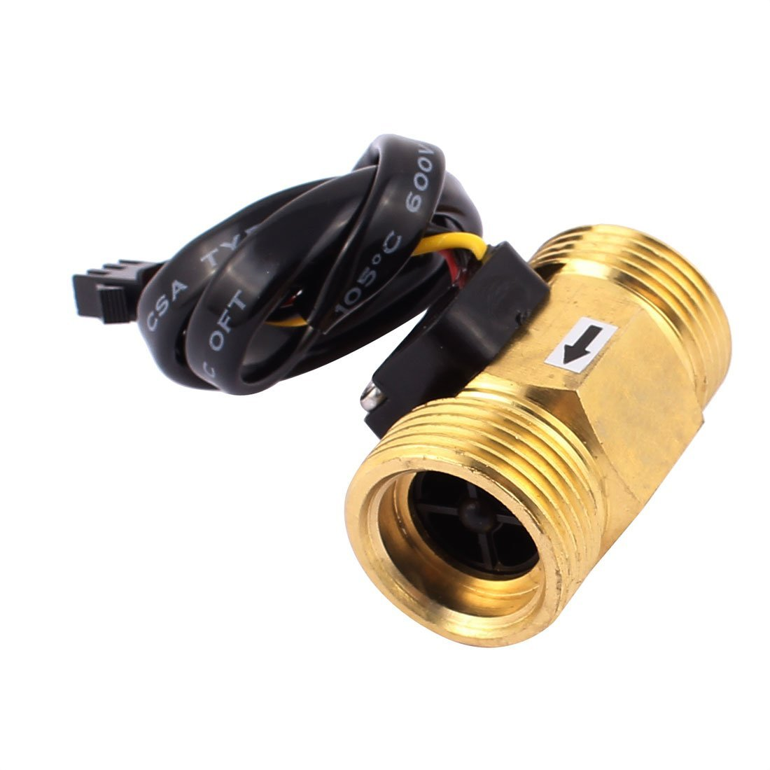
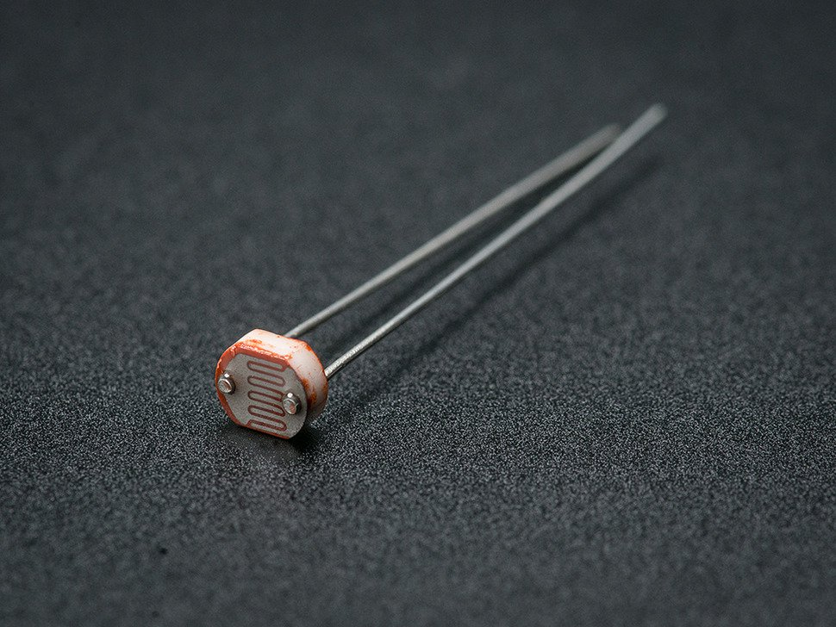
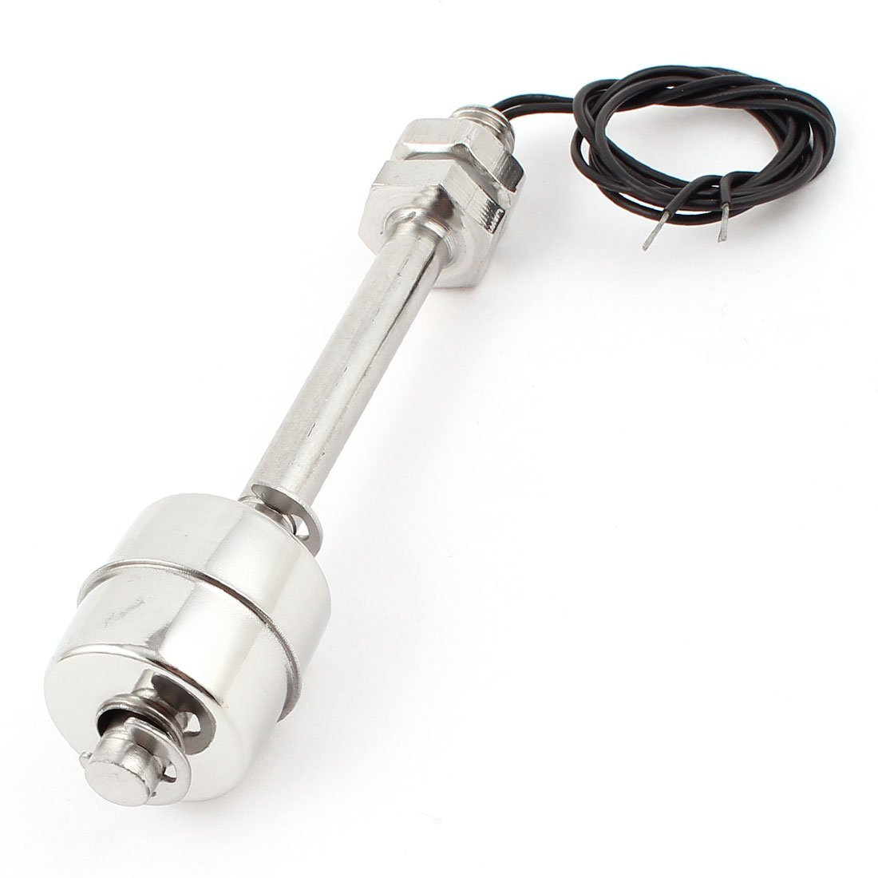
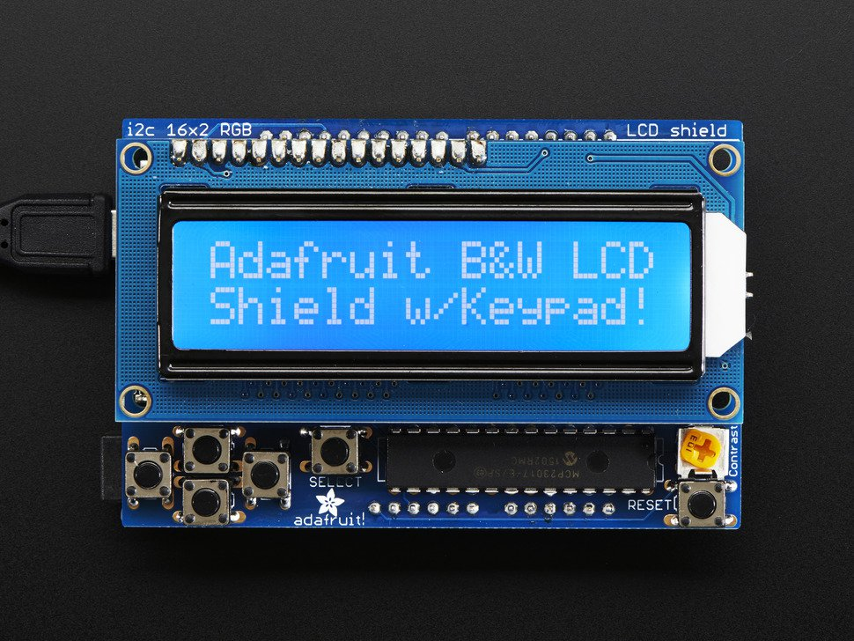
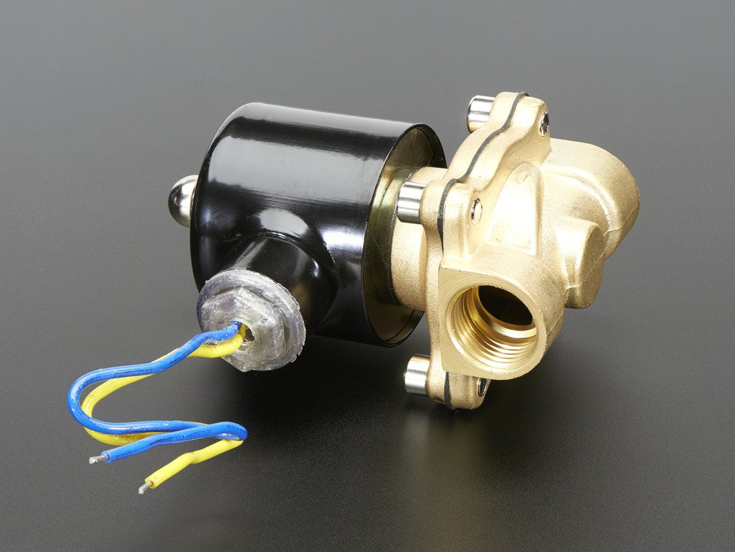
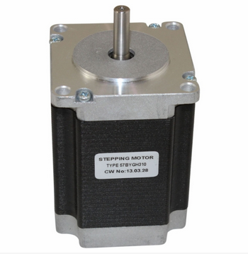
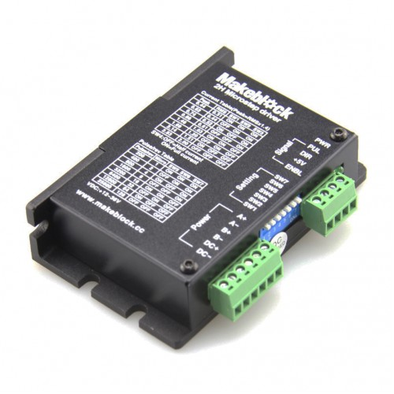
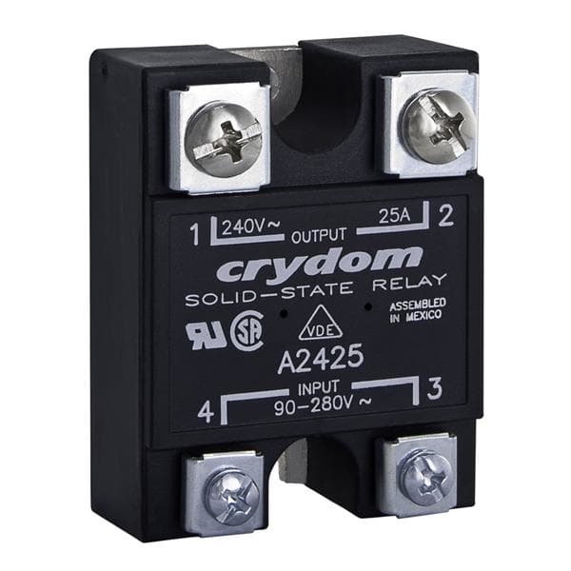
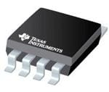
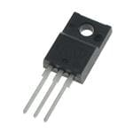
Parts and Prices:
1
2
3
4
5
6
7
8
9
10
11
1.) Aruidno
2.) Flow Sensor
3.) PhotoResistor
4.) Level Sensor
5.) LCD interface
6.) Electronic Valve
7.) Motor
8.) Motor Driver
10.) Voltage Regulator
11.) Transistor
1.) $24.95
2.) $10.00
3.) $.095
4.) 2x = $14.08
5.) $19.95
6.) $25.00
7.) 2x = 47.78
8.) 2x = $39.98
10.) $0.41
11.) $1.51
Estimated Transformer/Rectifier Bridge Costs Not Including 2.8kV Transfomer: $80.00
Total Cost: 264.61

